Slide 1


Introduction to Python Concepts
Explore the fundamental building blocks of the Python programming language, including syntax, data types, and control structures.
by Jagadabi Yaswanth Abhishek Varma
JV

Slide 2
Python Basics
Syntax and Structure: Explore the fundamental syntax and structure of the Python programming language, including variable declaration, data types, and control flow statements.
Data Manipulation: Learn how to work with Python's built-in data structures, such as lists, tuples, dictionaries, and sets, to perform efficient data manipulation and processing.
Control Flow: Understand how to use conditional statements (if-else), loops (for, while), and functions to control the flow of your Python programs and automate repetitive tasks.
Standard Library: Discover the vast array of modules and libraries in the Python standard library, which provide a wide range of functionalities for tasks like file I/O, networking, and data analysis.
Error Handling: Learn how to handle exceptions and errors in your Python code, ensuring your programs are robust and can gracefully handle unexpected situations.

Slide 3
Python Syntax Basics
Variable Declaration: Understand how to declare and assign values to variables in Python using intuitive syntax.
Data Types: Explore the built-in data types in Python, including integers, floats, strings, booleans, and more, and learn how to work with them effectively.
Operators and Expressions: Familiarize yourself with the various arithmetic, logical, and comparison operators available in Python, and learn how to construct complex expressions.
Control Flow: Discover how to use conditional statements like if-elif-else and looping constructs such as for and while to control the flow of your Python programs.
Function Basics: Understand the fundamentals of defining and calling functions in Python, including parameter passing and return values.

Slide 4
Object-Oriented Programming (OOP) in Python
Classes & Objects
Encapsulation & Abstraction
Polymorphism & Composition
Understand the core OOP concepts of classes, objects, and inheritance.
Learn how to implement data hiding and abstract away implementation details.
Discover how to write flexible, reusable code using polymorphism and object composition.

Slide 5

Classes & Objects in Python
In Python, classes serve as the blueprint for creating objects, which are instances of those classes. Objects encapsulate data (attributes) and functionality (methods) to represent real-world entities or concepts. By defining classes, you can create multiple objects that share common properties and behaviors, promoting code reuse and modularity.
Classes define the structure and behavior of objects, including their attributes (data) and methods (functions).
Objects are instances of classes that have their own unique state, represented by the values of their attributes.
Inheritance allows you to create new classes based on existing ones, inheriting their attributes and methods, promoting code reuse and polymorphism.
Encapsulation and data hiding techniques can be used to protect the internal state of objects and control access to their functionality.
Polymorphism enables objects of different classes to be treated as instances of a common superclass, making code more flexible and extensible.
Example :
class ClassName:
def __init__(self, parameters):
# Constructor method to initialize attributes
self.attribute1 = value1
self.attribute2 = value2
def method_name(self, parameters):
# Method definition
pass

Slide 6
Encapsulation & Abstraction
Data Encapsulation: Hiding the internal implementation details of an object and exposing only the necessary interfaces, promoting information hiding and abstraction.
Abstraction Principles: Focusing on the essential features and behaviors of an object, while hiding the non-essential details from the user.
Access Modifiers: Using access modifiers (e.g., public, private, protected) to control the visibility and accessibility of an object's attributes and methods.
Getter and Setter Methods: Providing controlled access to an object's internal state through getter and setter methods, ensuring data consistency and integrity.

Slide 7
Polymorphism & Composition
Polymorphism
Method Overriding
Object Composition
Flexibility
Polymorphism allows objects of different classes to be treated as instances of a common superclass. This enables flexible and extensible code by allowing objects to take on different forms depending on the context.
Polymorphism is often achieved through method overriding, where a subclass provides its own implementation of a method defined in the superclass. This allows the same method call to behave differently based on the object type.
Composition is a design principle where objects contain other objects as parts of themselves. This promotes code reuse and allows for the creation of complex systems by combining simpler building blocks.
By leveraging polymorphism and composition, you can write code that is more flexible, maintainable, and adaptable to changing requirements, making it a powerful tool in object-oriented programming.

Slide 8
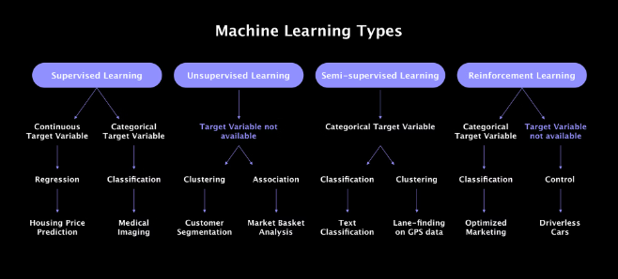
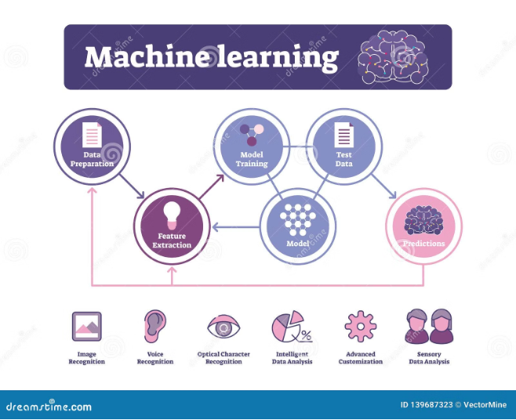
What is Machine Learning?
Defining Machine Learning
Machine learning is a field of artificial intelligence that enables computers to learn and improve from experience without being explicitly programmed. It involves developing algorithms that can analyze and learn from data to make predictions or decisions.
The Power of Algorithms
Machine learning algorithms are designed to adaptively improve their performance on a specific task by analyzing patterns and relationships within data. This allows them to uncover insights and make more accurate forecasts or recommendations over time.

Slide 9
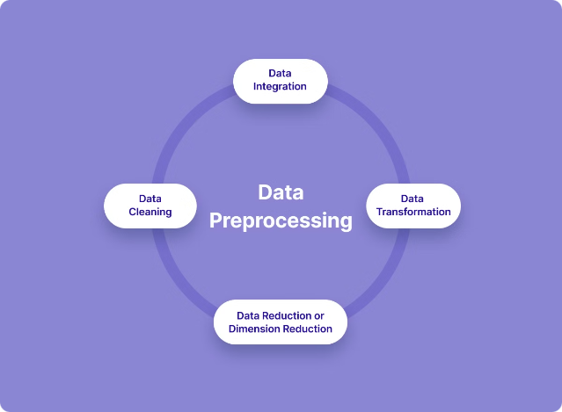
Data Preprocessing in Machine Learning
Data preprocessing is a crucial step in the machine learning pipeline. It involves cleaning, transforming, and preparing raw data to make it suitable for analysis and model training. This step ensures the quality and integrity of the data, which can significantly impact the performance of machine learning models.
Effective data preprocessing techniques, such as handling missing values, removing outliers, and scaling features, can greatly improve the accuracy and efficiency of machine learning algorithms. Visualizing the data can also provide valuable insights into the structure and relationships within the dataset, guiding the preprocessing steps.

Slide 10
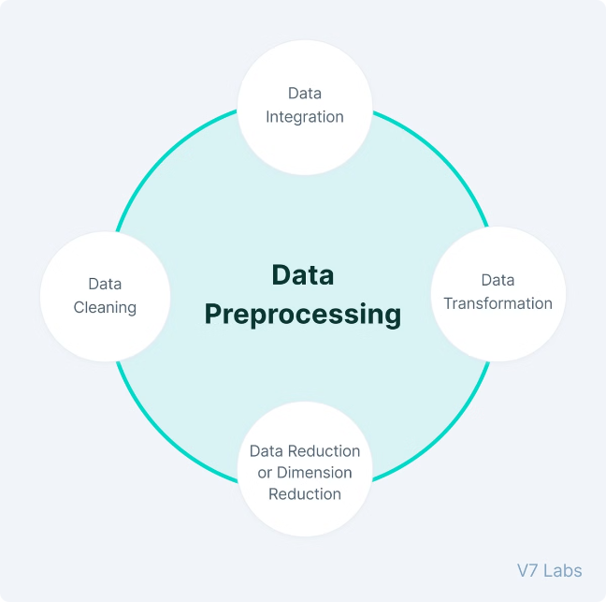
Data Preprocessing in Machine Learning
1
Data Cleaning
Handle missing values, remove duplicates, and ensure data integrity.
2
Feature Engineering
Create new features from existing data to improve model performance.
3
Normalization & Scaling
Standardize feature scales to ensure equal importance in the model.

Slide 11
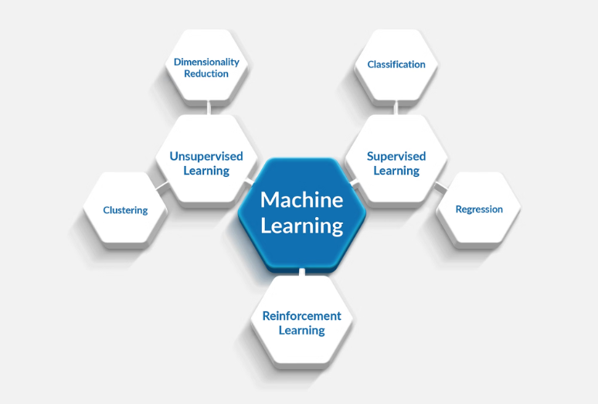
Supervised Machine Learning Algorithms
Supervised machine learning is a type of machine learning where the algorithm is trained on a labeled dataset, meaning the expected outputs are known. The algorithm learns to map the input data to the corresponding outputs, and can then make predictions on new, unseen data.
Linear Regression
Logistic Regression
Decision Trees
Random Forests
Support Vector Machines (SVMs)
These supervised algorithms are widely used for tasks like classification, regression, and prediction, and can be highly effective when given the right data and tuned appropriately.

Slide 12

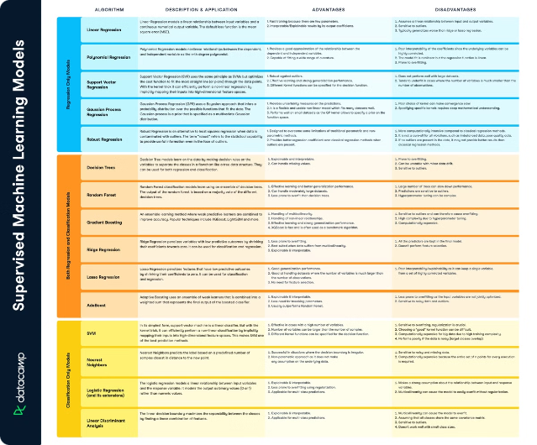
Supervised Machine Learning Algorithms
1
Linear Regression
2
Logistic Regression
Predict continuous target variables using linear relationships.
Classify data into discrete categories using sigmoid functions.
3
Decision Trees
4
Support Vector Machines
Recursively split data based on feature importance to make predictions.
Find the optimal hyperplane to separate data into distinct classes.

Slide 13

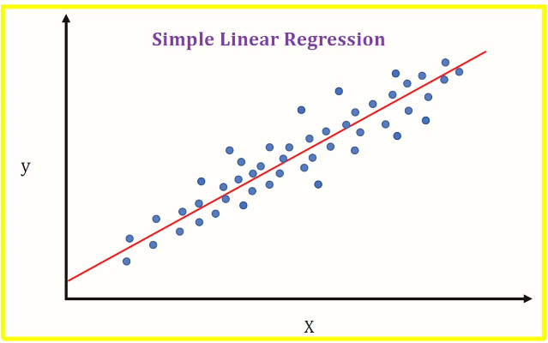
Linear Regression and its Algorithms
The linear regression algorithm models the relationship between input features and a continuous target variable using a linear equation in the form y = mx + b.
Linear regression is a powerful tool for tasks like forecasting, price prediction, and trend analysis, where the goal is to predict a continuous numeric output.
There are several algorithm variations, such as Ordinary Least Squares, Ridge Regression, and Lasso Regression, that can be used to optimize the linear regression model.

Slide 14

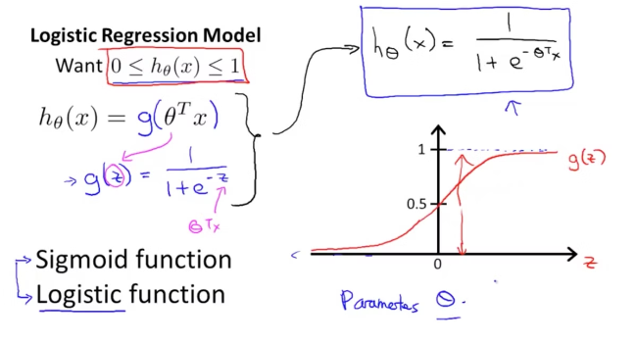
Logistic Regression
Logistic regression is a powerful supervised learning algorithm used for binary classification tasks. It models the relationship between input features and a discrete, categorical target variable by applying the logistic sigmoid function to produce probabilistic outputs.
Classification: Logistic regression excels at predicting whether an instance belongs to one of two classes, such as spam/not spam or tumor/no tumor.
Probability Estimation: The algorithm outputs the probability of an instance belonging to each class, providing valuable insights beyond simple binary decisions.
Feature Importance: Logistic regression models can be analyzed to determine the relative importance of each input feature, aiding in feature selection and model interpretation.
Logistic regression is a versatile and widely-used algorithm in machine learning, with applications in areas like credit risk assessment, email filtering, and medical diagnosis.

Slide 15



Decision Trees
Prediction
1
Classify new data
Split Criteria
2
Choose best feature to split on
Feature Importance
3
Analyze relevance of each feature
Decision trees are a powerful supervised learning algorithm that recursively splits the data based on feature importance to build a tree-like model for making predictions. By analyzing the structure of the tree, you can gain valuable insights into which features are most relevant for the target task.

Slide 16
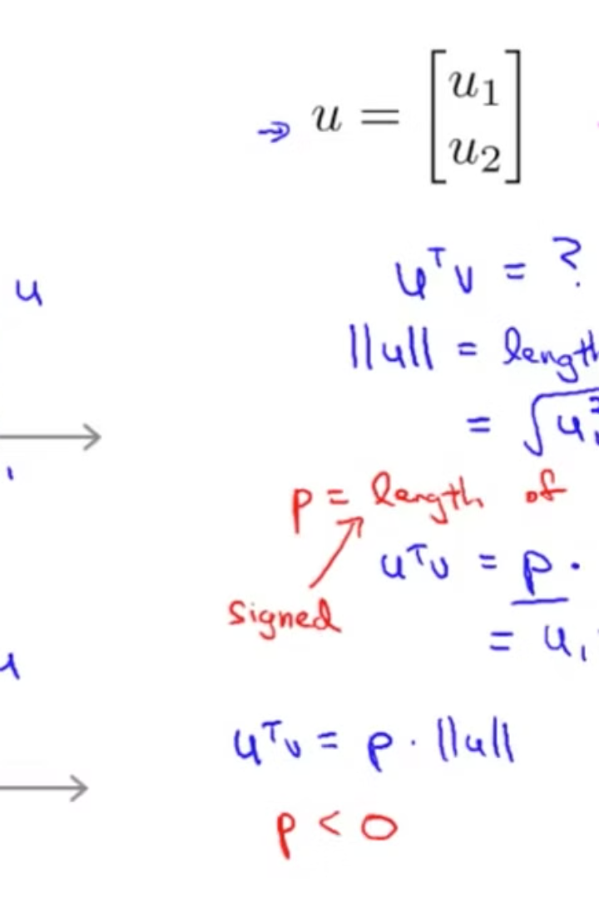
Support Vector
Support Vector Machines (SVMs) are a powerful supervised learning algorithm used for both classification and regression tasks. SVMs find the optimal hyperplane that maximizes the margin between two or more classes, making them highly effective at separating complex, non-linear data.

Slide 17

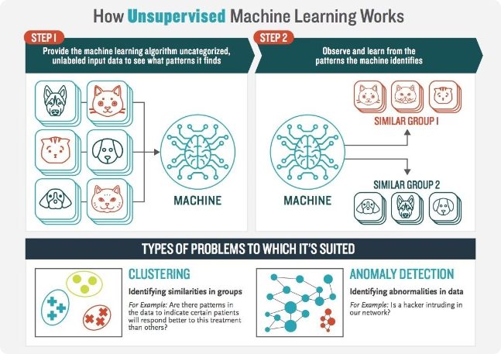
Unsupervised Machine Learning Algorithms
K-Means Clustering
Principal Component Analysis
Group data into k clusters based on similarity of feature values.
Reduce feature dimensionality while preserving maximum data variance.
Anomaly Detection
Association Rule Mining
Identify outliers and unusual data points in a dataset.
Discover hidden relationships and patterns in unstructured data.

Slide 18

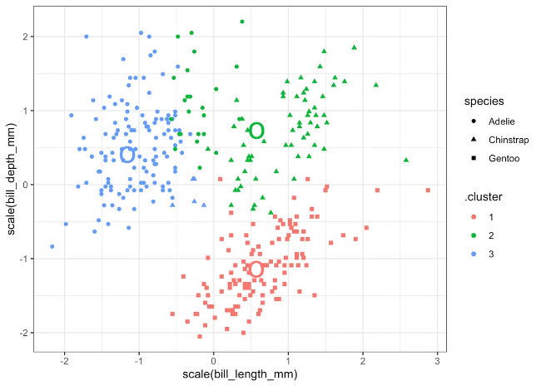
K-Means Clustering
K-Means Clustering is an unsupervised machine learning algorithm used to group similar data points into distinct clusters. It works by iteratively assigning data points to the nearest cluster centroid, then recalculating the centroids until the clusters stabilize.
Partitioning Data: K-Means divides the data into k clusters based on feature similarity, where k is a predetermined number.
Centroid Optimization: The algorithm updates the cluster centroids to minimize the total within-cluster variance, improving cluster assignments.
Scalable and Efficient: K-Means is a computationally efficient algorithm that can handle large datasets and high-dimensional features.
K-Means Clustering is a versatile technique used for market segmentation, image compression, and anomaly detection. The algorithm's simplicity and effectiveness make it a popular unsupervised learning method in data science and machine learning applications.

Slide 19


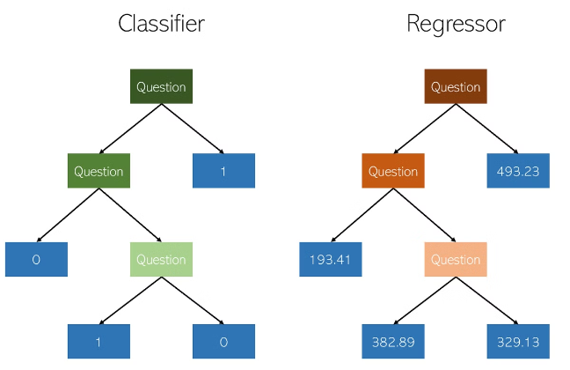


Regression Models in Machine Learning
Linear Regression
Predicts a continuous target variable using a linear function.
Polynomial Regression
Fits a non-linear polynomial function to the data.
Logistic Regression
Models the probability of a binary classification outcome.

Slide 20





Applications of Machine Learning
Image Recognition
Natural Language Processing
Recommendation Systems
Autonomous Vehicles
Classify images into different categories.
Enable self-driving cars to perceive their environment and make decisions.
Understand and generate human language.
Suggest products, content, or information based on user preferences.

